Slide 1
Succinct Blind Quantum Computation Using a Random Oracle
Jiayu Zhang, Boston University, jyz16@bu.edu
ArXiv:2004.12621

Slide 2
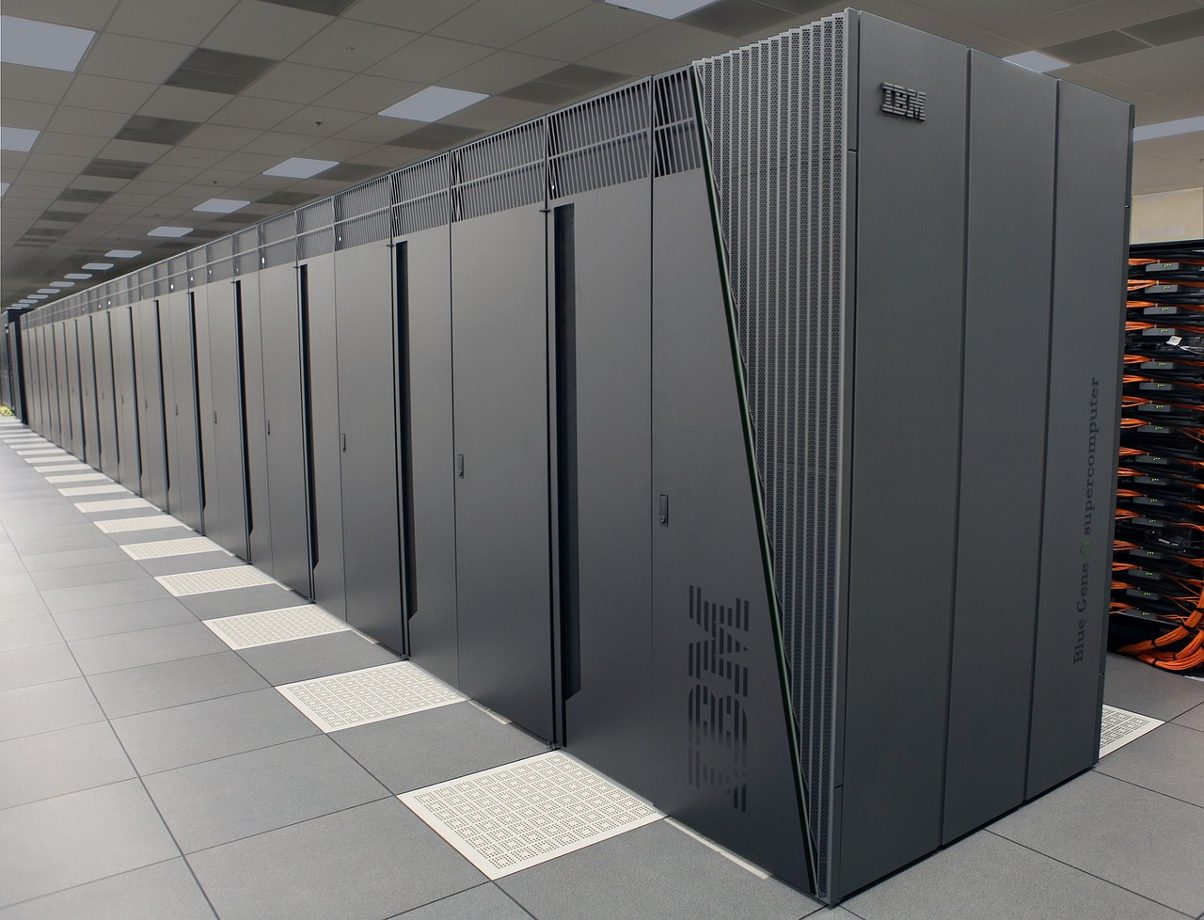


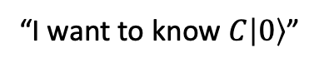
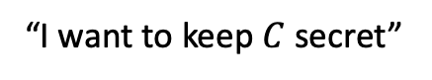
What is blind quantum computation? [Childs’06]
“I want to know $C|0〉$”
Classical/Quantum interactions
“I want to keep $C$ secret”
A fundamental problem in quantum cryptography
New techniques often led to advances in related problems
This work: universal BQC protocol with “succinct” client-side quantum computation, in the random oracle model
Models idealized symmetric-key primitives

Slide 3
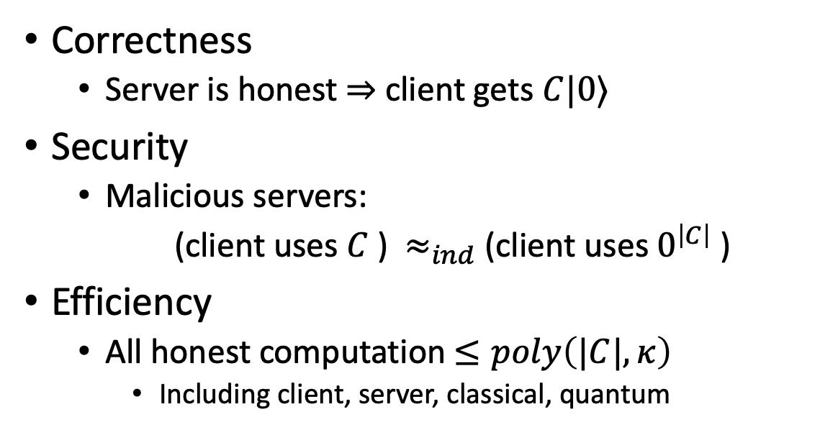
“Minimum Requirements” on Blind Quantum Computation
Correctness
Server is honest $⇒$ client gets $C|0⟩$
Security
Malicious servers:
(client uses $C$ ) $≈_{ind}$ (client uses $0^{\left|C\right|}$ )
Efficiency
All honest computation $≤poly\left(|C|,κ\right)$
Including client, server, classical, quantum
Indistinguishable by relevant class of adversaries (e.g. unbounded/polynomial time/…)
This work: universal BQC protocol with “succinct” client-side quantum computation, in the random oracle model

Slide 4
Existing Works (universal, single-server)
Information-theoretically secure protocols
Representative: UBQC by Broadbent-Fitzsimons-Kashefi (FOCS09)
Size of quantum gadgets ~ |C|
Protocols based on trapdoor assumptions (public key encryption)
Early representative: Dulek-Schaffner-Speelman (Crypto16)
Mahadev (FOCS18)
Assumption: Learning-With-Errors
Classical client

Slide 5
Public-key versus symmetric-key crypto
Symmetric key encryption
Related: pseudorandom generator, oneway function, etc
Example: AES etc (many choices)
Public key encryption
Related: trapdoor function, etc
Example: Learning-With-Error, RSA
Broken by Shor’s algorithm

Slide 6
Existing Works (universal, single-server)
Information-theoretically secure protocols
Representative: UBQC by Broadbent-Fitzsimons-Kashefi (FOCS09)
Two phases: send quantum gadgets; classical computation.
Size of quantum gadgets ~ |C|
Known IT-secure protocols require linear in |C| client-side quantum computation
Protocols based on trapdoor assumptions (public key encryption)
Early representative: Dulek-Schaffner-Speelman (Crypto16)
Mahadev (FOCS18)
Assumption: Learning-With-Errors
Classical client

Slide 7
What if we have only symmetric-key cryptographic primitives?
Specific goal: Client side quantum computation independent of circuit size |C|

Slide 8
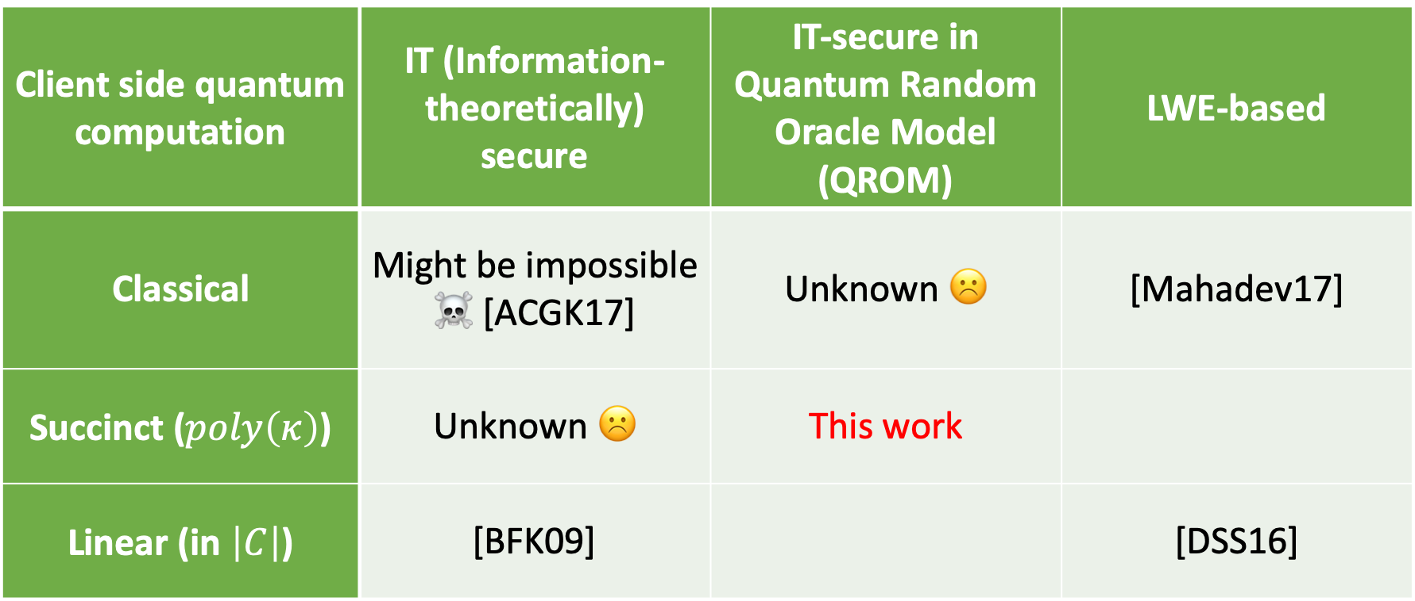
If we classify protocols based on client-side quantum computation and assumptions…
Models idealized symmetric-key primitives
Client side quantum computation | IT (Information-theoretically) secure | IT-secure in Quantum Random Oracle Model (QROM) | LWE-based
Classical | Might be impossible ☠️ [ACGK17] | Unknown ☹️ | [Mahadev17]
Succinct ($poly\left(κ\right)$) | Unknown ☹️ | This work
Linear (in $\left|C\right|$) | [BFK09] |  | [DSS16]

Slide 9
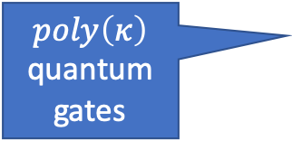

Our protocol
Correct and efficient
Two phases:
Secure against unbounded adversary that makes subexponential number of random oracle queries. (next page)
Sends $poly(κ)$ gadgets (independent of $C$)
$poly\left(κ\right)$ quantum gates
Classical interaction

Slide 10
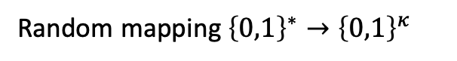

Quick Preliminaries: Quantum Random Oracle Model (QROM)
Raised in [BDFLSZ11] as a quantum generalization of classical random oracle model
Random mapping ${\left\{0,1\right\}}^{∗}→{\left\{0,1\right\}}^{κ}$
$$H$$
All parties can query.
An ideal model for hash functions / symmetric key encryption
“Random Oracle Methodology”:
Design in QROM, instantiate with hash function / block cipher
Security claim is ultimately heuristic
Formal setting…
But there exist uninstantiable constructions [CGH00, ES20]
QROM and ROM extensively studied
Provide only known constructions of many cryptographic protocols

Slide 11
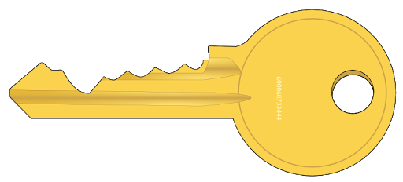

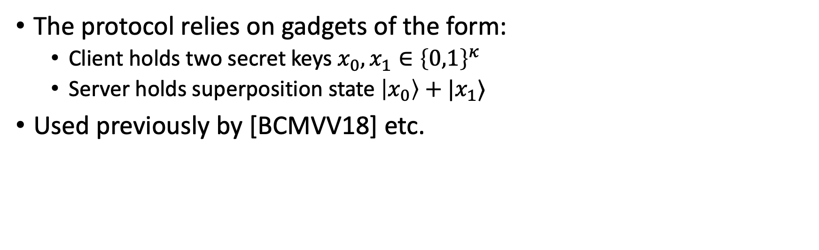
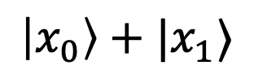
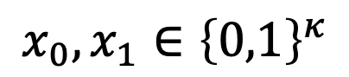
Gadgets
$$x_{0},x_{1}∈{\left\{0,1\right\}}^{κ}$$
$$\left|x_{0}\right\rangle +|x_{1}⟩$$
$$\left| \right\rangle +| ⟩$$
The protocol relies on gadgets of the form:
Client holds two secret keys $x_{0},x_{1}∈{\left\{0,1\right\}}^{κ}$
Server holds superposition state $\left|x_{0}\right\rangle +|x_{1}⟩$
Used previously by [BCMVV18] etc.

Slide 12
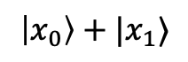

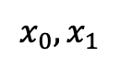
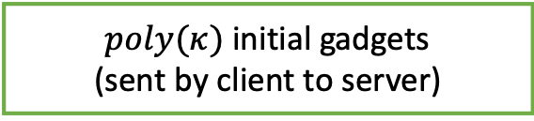
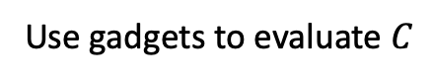
A Top-down Overview of Our Construction
Each gadget:
$poly(κ)$ initial gadgets (sent by client to server)
$$x_{0},x_{1}$$
$$\left|x_{0}\right\rangle +|x_{1}⟩$$
[BCMVV18]
expand to enough gadgets via classical interaction.
This step is the most work…💪 💪
“Remote gadget preparation” via:
Designing a weakly-secure gadget-increasing protocol
Robust reversible garbled tables, padded Hadamard test, parallel repetition etc…
Amplifying security
“Repeat-and-combine”
$Θ\left(\left|C\right|\right)$ “secure enough” gadgets
Use gadgets to evaluate $C$
Also nontrivial…💪
Time arrow

Slide 13


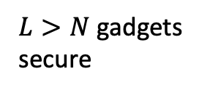

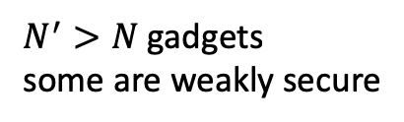
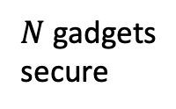

An informal illustration
$N$ gadgets
secure
$$\left| \right\rangle +| ⟩$$
$$\left| \right\rangle +| ⟩$$
$$\left| \right\rangle +| ⟩$$
Gadget-generating and
amplification steps
are interlaced
……
$$\left| \right\rangle +| ⟩$$
$$\left| \right\rangle +| ⟩$$
$$\left| \right\rangle +| ⟩$$
$$\left| \right\rangle +| ⟩$$
$$\left| \right\rangle +| ⟩$$
$$\left| \right\rangle +| ⟩$$
$$\left| \right\rangle +| ⟩$$
(Not “first do this, then do that, done”)
$N^{′}>N$ gadgets some are weakly secure
$$\left| \right\rangle +| ⟩$$
$$\left| \right\rangle +| ⟩$$
……
$$\left| \right\rangle +| ⟩$$
$L>N$ gadgets secure
$$\left| \right\rangle +| ⟩$$
$$\left| \right\rangle +| ⟩$$
$$\left| \right\rangle +| ⟩$$
$$\left| \right\rangle +| ⟩$$

Slide 14
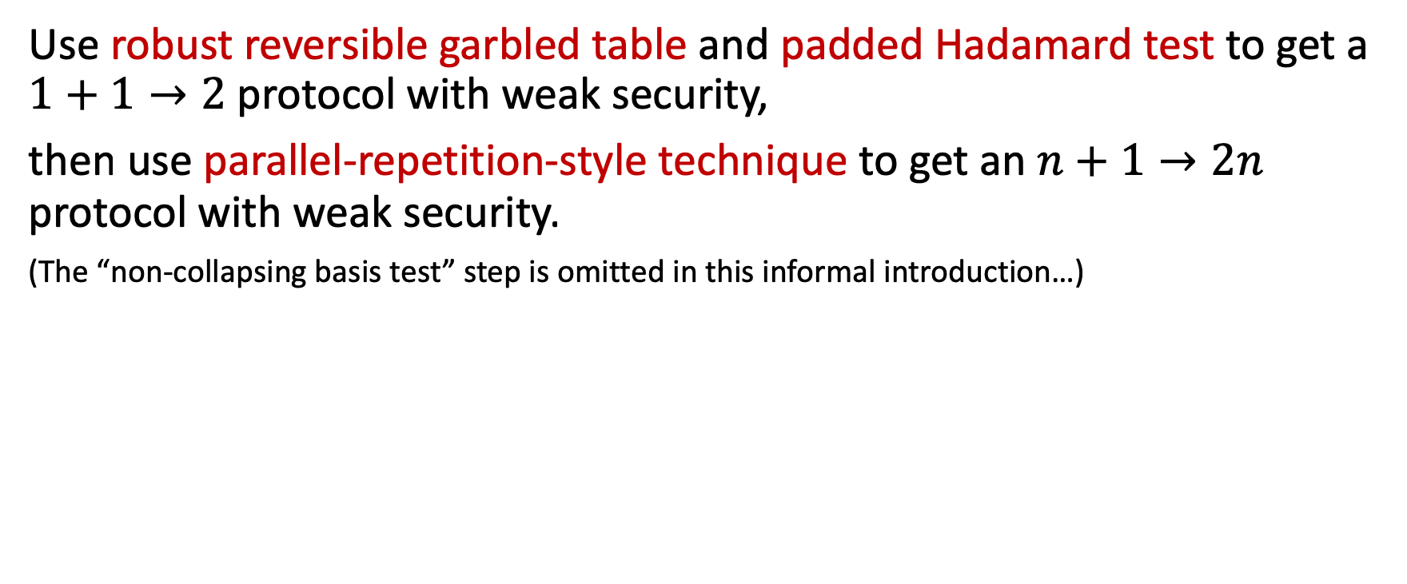
A Weakly-secure gadget-increasing Protocol
Use robust reversible garbled table and padded Hadamard test to get a $1+1→2$ protocol with weak security,
then use parallel-repetition-style technique to get an $n+1→2n$ protocol with weak security.
(The “non-collapsing basis test” step is omitted in this informal introduction…)
Gadget- increasing

Slide 15
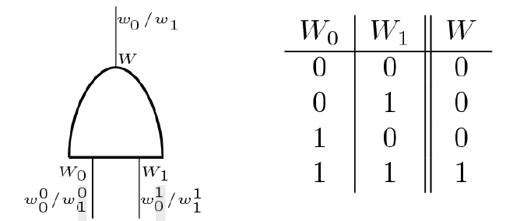
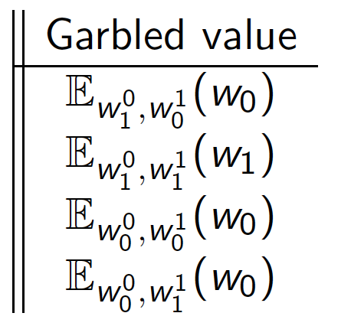
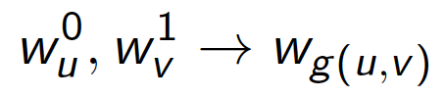
Quick Preliminaries: Garbled Tables
A fundamental construction in classical cryptography
𝔼: a symmetric key encryption scheme
implements mapping

Slide 16
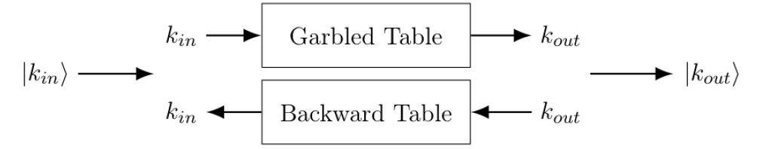
Quick Preliminaries: Reversible Garbled Tables
The following mapping can be implemented using this table:
Can be applied on superpositions

Slide 17
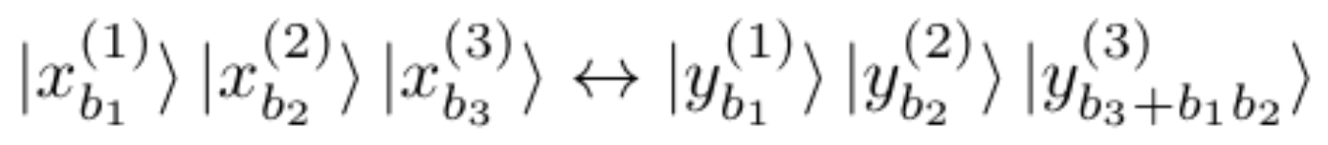
Failed Attempts towards a Weakly-Secure, Gadget-increasing Protocol
Attempt 1: reversible garbled table + input gadgets.
Could a reversible garbled table increase the number of gadgets?
Let’s see…
Garble a Toffoli gate…
Prepare the input gadgets…
Secure but not gadget-increasing…☹️

Slide 18
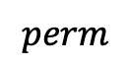
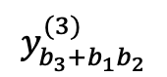
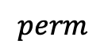
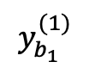

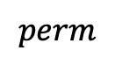

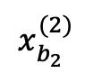

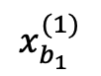
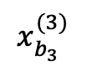


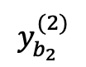
An additional bit-wise permutation is sampled to strengthen the security
RobustRGT
$$x_{b_{1}}^{(1)}$$
RevGT
(Toffoli)
$$y_{b_{1}}^{(1)}$$
$$x_{b_{2}}^{(2)}$$
$$y_{b_{2}}^{(2)}$$
$$perm$$
$$y_{b}$$
$$y_{b}^{′}$$
$$x_{b_{3}}^{(3)}$$
$$y_{b_{3}+b_{1}b_{2}}^{(3)}$$
$$perm$$
$$perm(y_{b}||y_{b}^{′})$$
Which implements the mapping
$$\left| \right\rangle +\left| \right\rangle ⊗|. ⟩+| ⟩$$
$$perm$$
Additional protection by bitwise-permutation
$$perm(\left(\left|y_{0}\right\rangle +\left|y_{1}\right\rangle \right)⊗\left(\left|y_{0}^{′}\right\rangle +|y_{1}^{′}⟩\right))$$

Slide 19
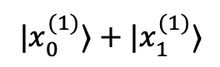
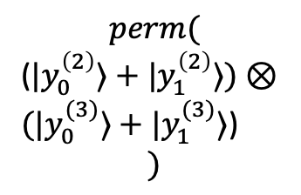
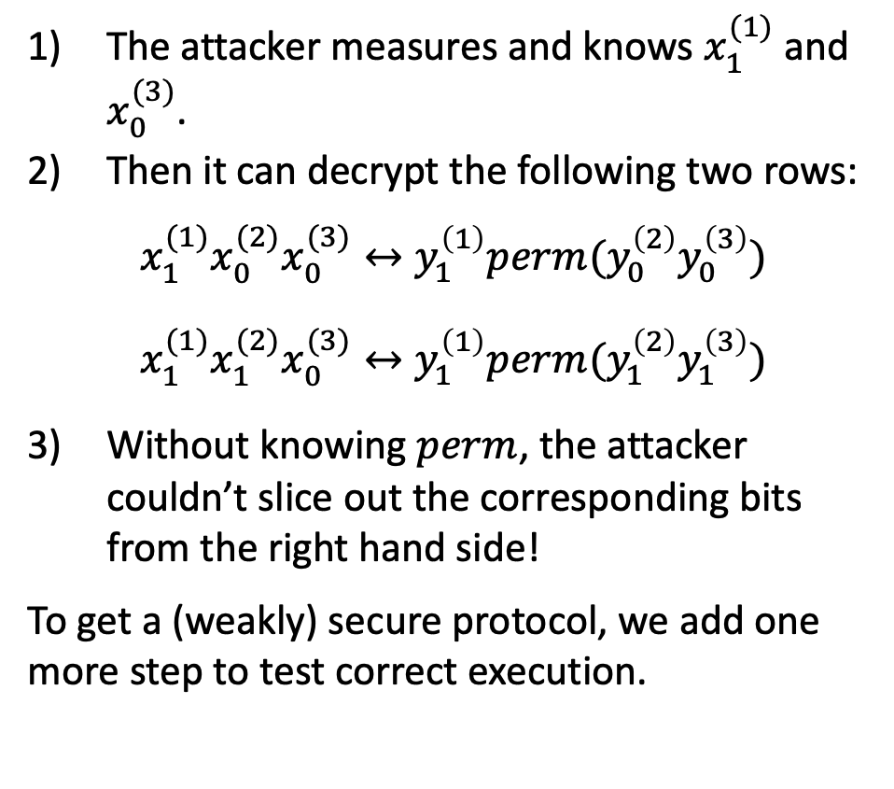
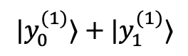
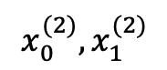
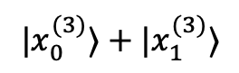
Intuitive Security Analysis for RobustRGT
The attacker measures and knows $x_{1}^{(1)}$ and $x_{0}^{(3)}$.
Then it can decrypt the following two rows:
$$x_{1}^{(1)}x_{0}^{(2)}x_{0}^{(3)}↔y_{1}^{\left(1\right)}perm(y_{0}^{\left(2\right)}y_{0}^{\left(3\right)})$$
$$x_{1}^{(1)}x_{1}^{(2)}x_{0}^{(3)}↔y_{1}^{\left(1\right)}perm(y_{1}^{\left(2\right)}y_{1}^{\left(3\right)})$$
Without knowing $perm$, the attacker couldn’t slice out the corresponding bits from the right hand side!
To get a (weakly) secure protocol, we add one more step to test correct execution.
$$|x_{0}^{(1)}⟩+|x_{1}^{(1)}⟩$$
RobustRGT
$$|y_{0}^{(1)}⟩+|y_{1}^{(1)}⟩$$
$$x_{0}^{(2)}, x_{1}^{(2)}$$
$$perm($$
($|y_{0}^{\left(2\right)}⟩+|y_{1}^{\left(2\right)}⟩)⊗$
$(|y_{0}^{(3)}⟩+|y_{1}^{(3)}⟩$)
$$)$$
$$|x_{0}^{(3)}⟩+|x_{1}^{(3)}⟩$$

Slide 20
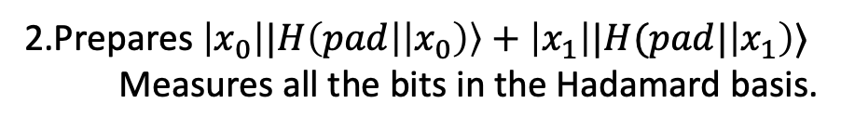
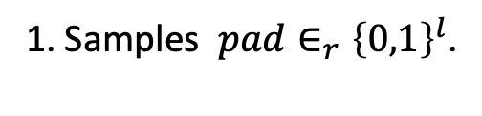
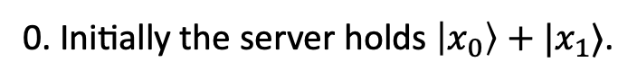
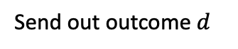
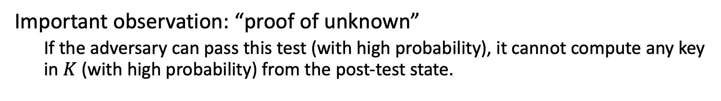

Padded Hadamard Test
A padded variant of “Hadamard test” in [BCMVV18].
0. Initially the server holds $\left|x_{0}\right\rangle +|x_{1}⟩$.
Send out $pad$
1. Samples $pad∈_{r}{\left\{0,1\right\}}^{l}$.
2.Prepares $\left|x_{0}\right||H\left(pad | \left|x_{0}\right)\right\rangle +\left|x_{1}\right||H(pad|\left|x_{1}\right)⟩$
Measures all the bits in the Hadamard basis.
Send out outcome $d$
3. Checks $d⋅x_{0}||H(pad|\left|x_{0}\right)=d⋅x_{1}||H(pad||x_{1})$.
Important observation: “proof of unknown”
If the adversary can pass this test (with high probability), it cannot compute any key in $K$ (with high probability) from the post-test state.

Slide 21
An informal illustration
$N$ gadgets
secure
$$\left| \right\rangle +| ⟩$$
$$\left| \right\rangle +| ⟩$$
$$\left| \right\rangle +| ⟩$$
Gadget-generating and
amplification
……
$$\left| \right\rangle +| ⟩$$
$$\left| \right\rangle +| ⟩$$
$$\left| \right\rangle +| ⟩$$
$$\left| \right\rangle +| ⟩$$
“Repeat and Combine”
$$\left| \right\rangle +| ⟩$$
$$\left| \right\rangle +| ⟩$$
$$\left| \right\rangle +| ⟩$$
$N^{′}>N$ gadgets some are weakly secure
$$\left| \right\rangle +| ⟩$$
$$\left| \right\rangle +| ⟩$$
……
$$\left| \right\rangle +| ⟩$$
$L>N$ gadgets secure
$$\left| \right\rangle +| ⟩$$
$$\left| \right\rangle +| ⟩$$
$$\left| \right\rangle +| ⟩$$
$$\left| \right\rangle +| ⟩$$

Slide 22
Summary
A universal blind quantum computation protocol for circuits of size $≤subexp(κ)$:
Thanks!

Slide 23
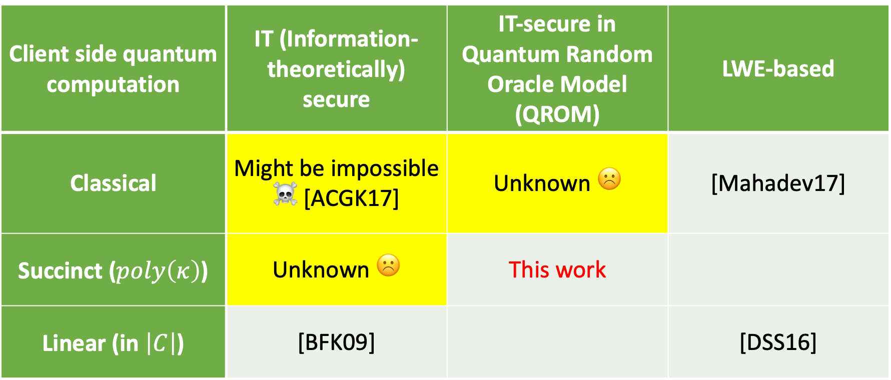
Summary & Some Open Questions
Client side quantum computation | IT (Information-theoretically) secure | IT-secure in Quantum Random Oracle Model (QROM) | LWE-based
Classical | Might be impossible ☠️ [ACGK17] | Unknown ☹️ | [Mahadev17]
Succinct ($poly\left(κ\right)$) | Unknown ☹️ | This work
Linear (in $\left|C\right|$) | [BFK09] |  | [DSS16]
Repeat table from beginning (smaller)
Mention trapdoor functions from QROM?
Verification?

Slide 24
Thank You!
[BDFLSZ11] Boneh, Dan & Dagdelen, Özgür & Fischlin, Marc & Lehmann, Anja & Schaffner, Christian & Zhandry, Mark. Random Oracles in a Quantum World. Asiacrypt 2011
[CGH00] Canetti, Ran and Goldreich, Oded and Halevi, Shai. The Random Oracle Methodology, Revisited. J. ACM 2004
[BCMVV18] Zvika Brakerski, Paul Christiano,Urmila Mahadev, Umesh Vazirani, Thomas Vidick. A Cryptographic Test of Quantumness and Certifiable Randomness from a Single Quantum Device. FOCS18
[Mahadev18] Urmila Mahadev. Classical Verification of Quantum Computation. FOCS18.
[ACGK17] Scott Aaronson, Alexandru Cojocaru, Alexandru Gheorghiu, Elham Kashefi Complexity Theoretic Limitation of Information-theoretically Secure Blind Quantum Computation. ICALP 2019
[DSS16] Yfke Dulek, Christian Schaffner, Florian Speelman, Quantum Homomorphic Encryption for Polynomial-Sized Circuits, CRYPTO 2016

